Slide 1

Leadership Compass
Lunch and Lead?

Slide 2
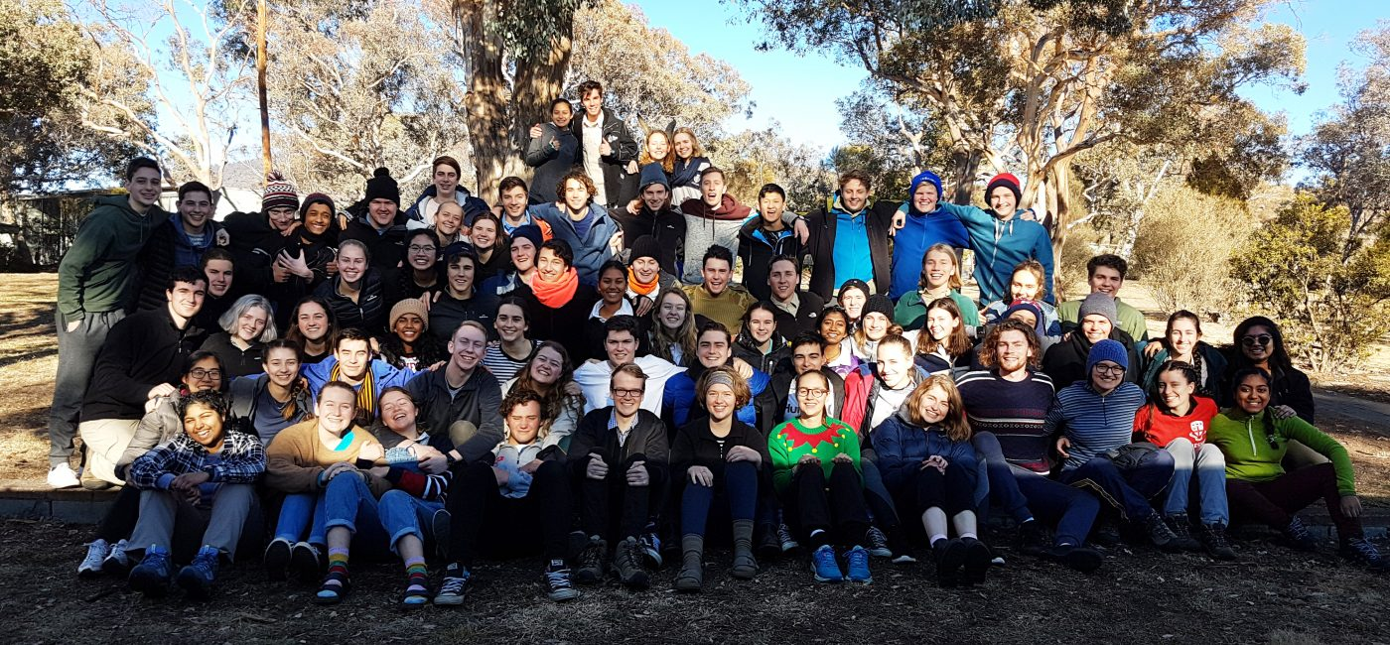
Disclosure Warning
I am not an experienced leader, life coach, manager, etc.
I just took part in this exercise at a youth STEM camp + Young Endeavour and want to share the experiment with you all today

Slide 3

Straight into the activity
It’s better to know nothing at all and jump straight into the activity
Let’s go!

Slide 4
Leadership Compass
Four “types” of leaders
Very generalised
Rough indication of your leadership style
Valuable knowing ‘your style’ in your team
Notes:
https://www.surveymonkey.com/r/CP78QFR
http://bonnernetwork.pbworks.com/f/BonCurLeadershipCompass.pdf
https://www.bethechangeconsulting.com/wp-content/uploads/2021/05/Leadership-compass-self-assessment.pdf
https://www.everyday-democracy.org/sites/default/files/attachments/Leadership%20Compass%20Activity.docx
http://intranet.okstate.edu/staff_development/extension-council-pac-folder/Leadership%20Compass%20Assessment%20Lesson%20Plan.pdf

Slide 5
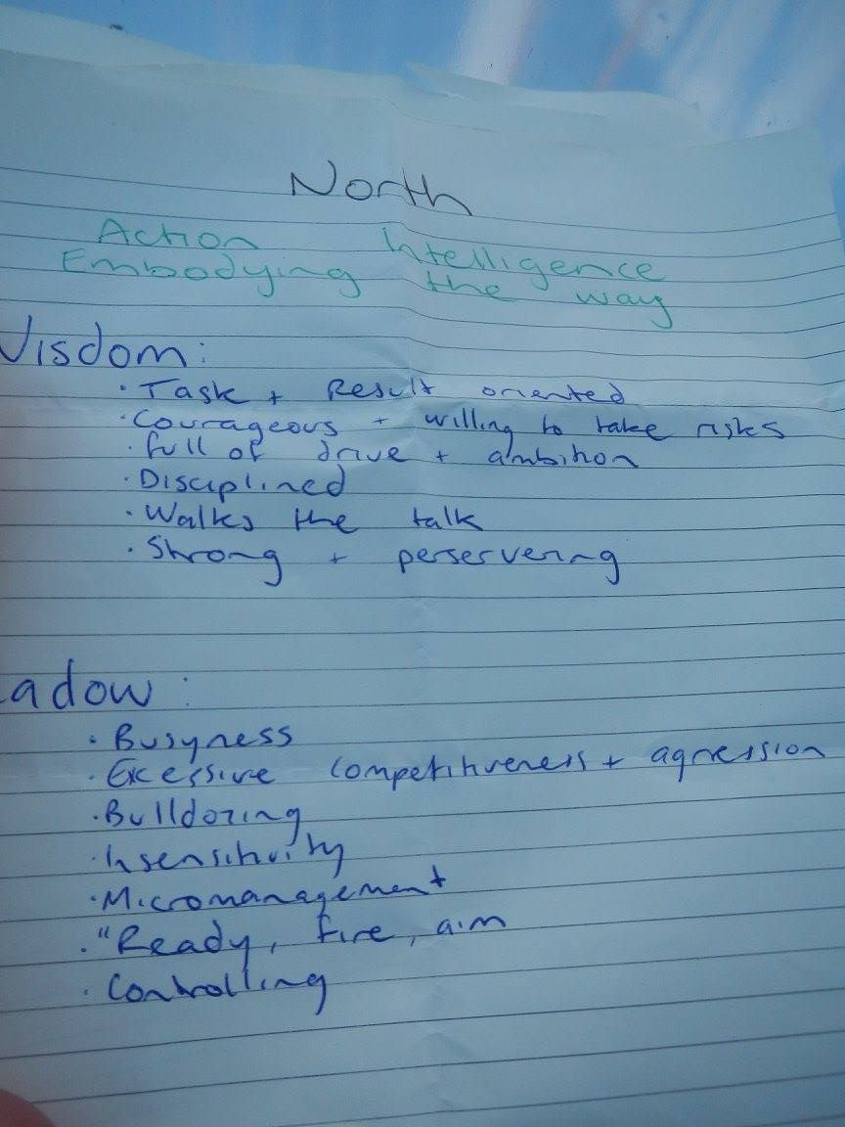
North - Mobilisers
“Do it now!”

Slide 6
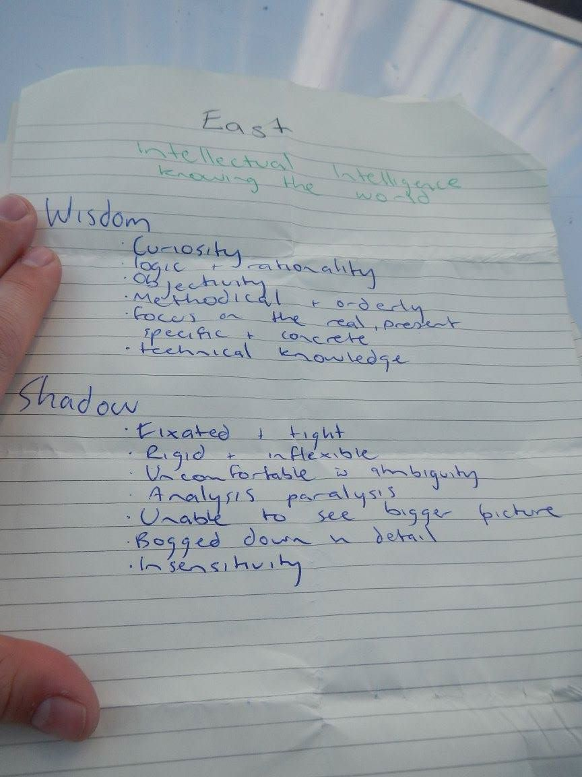
East - Visionaries
“I have an idea”

Slide 7
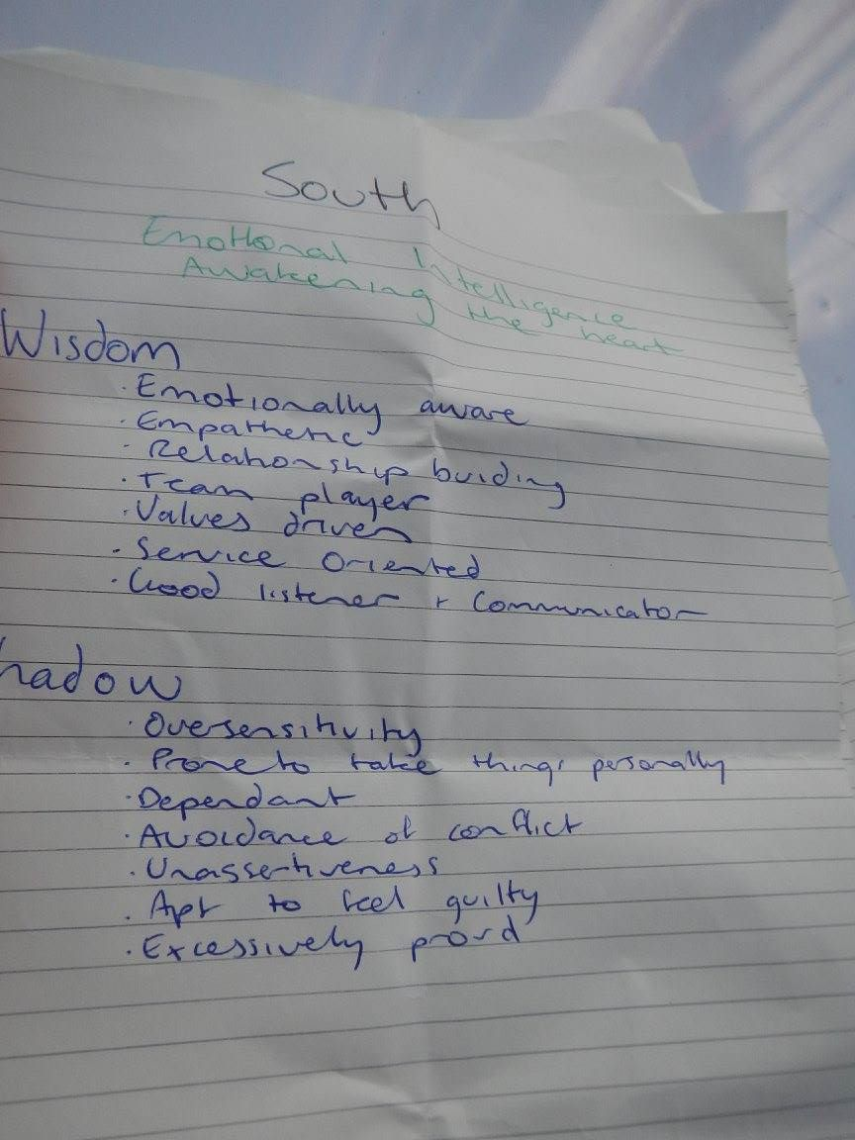
South - Nurturers
“Let’s think about others”

Slide 8
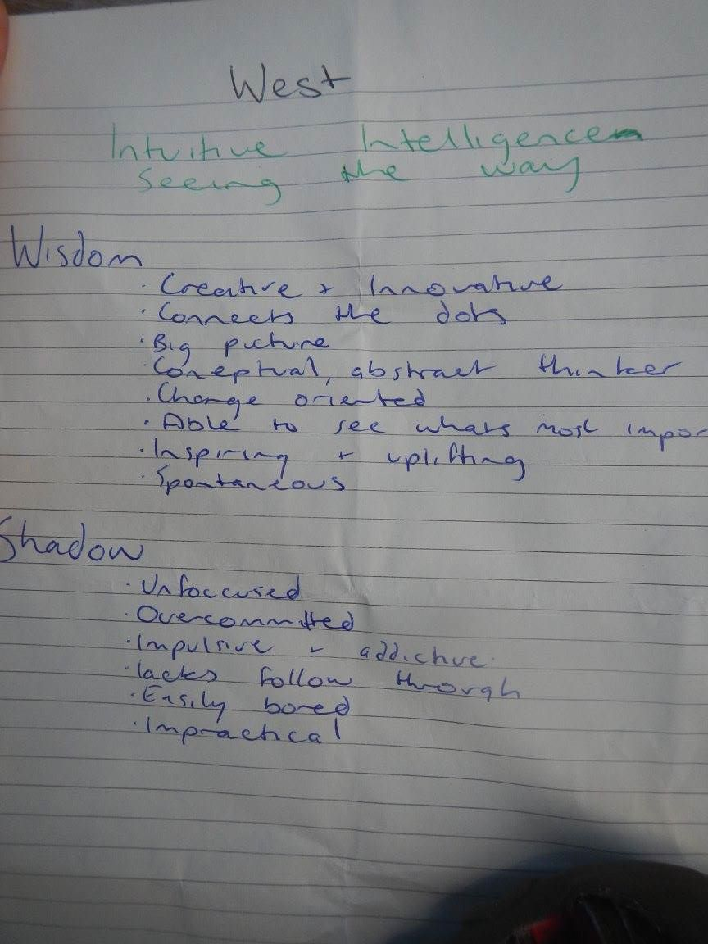
West - Teachers
“Details, details, details”

Slide 9
Surprise!
There’s more!

Slide 10
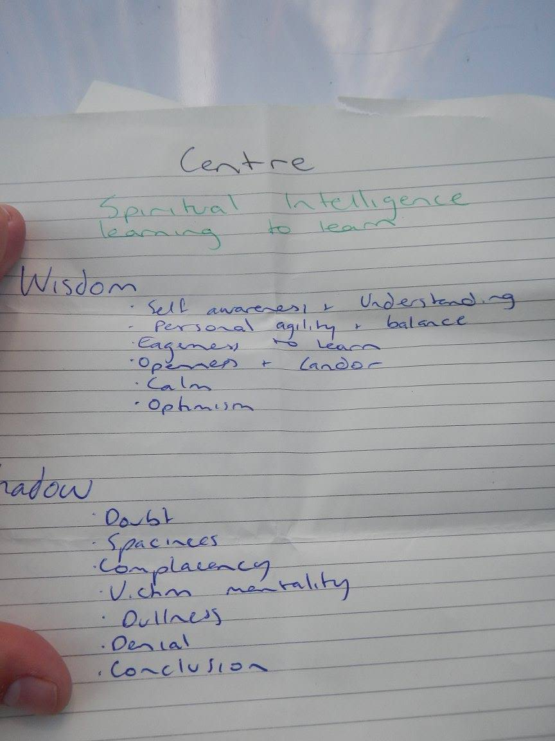
Centre - Sage

